Slide 1
recovering 3d information with a sinGle camera
Haoran Liang (Simon)
Multidisciplinary Minor in Imaging
Final Project Presentation
Notes:
Photo of project/demo.
Multidisciplinary Minor in Imaging
Final Project Presentation

Slide 2
Overview
Math
Procedure
Demo
Issues / Concerns
Q&A

Slide 3


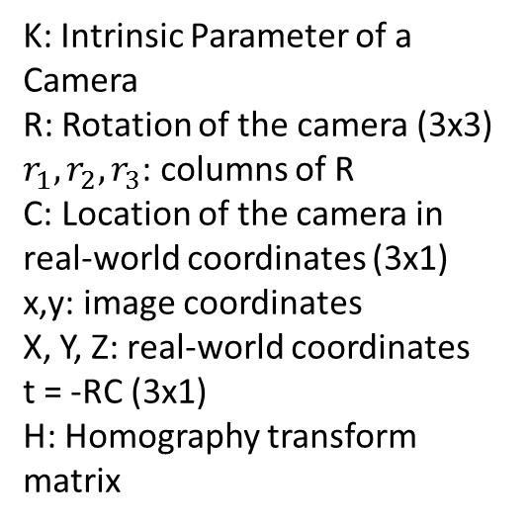

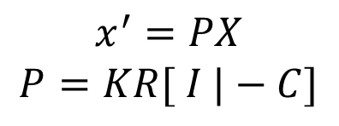
Math
$$x^{′}=PX$$
$$P=KR[ I |−C]$$
K: Intrinsic Parameter of a Camera
R: Rotation of the camera (3x3)
$r_{1}, r_{2}, r_{3}$: columns of R
C: Location of the camera in real-world coordinates (3x1)
x,y: image coordinates
X, Y, Z: real-world coordinates
t = -RC (3x1)
H: Homography transform matrix
$$x^{′}=Hx$$
Since we only have one camera, we will have to know K and X, Y, Z
Source: JP Mellor, CSSE 461 Computer Vision, and
http://www.epixea.com/research/multi-view-coding-thesisse9.html
Notes:
Key: Know intrinsic params of the camera, real-world (size of square)
Need a list of what each variable means, including K.
Insert a slide after showing visual example of as many of the params as possible.

Slide 4
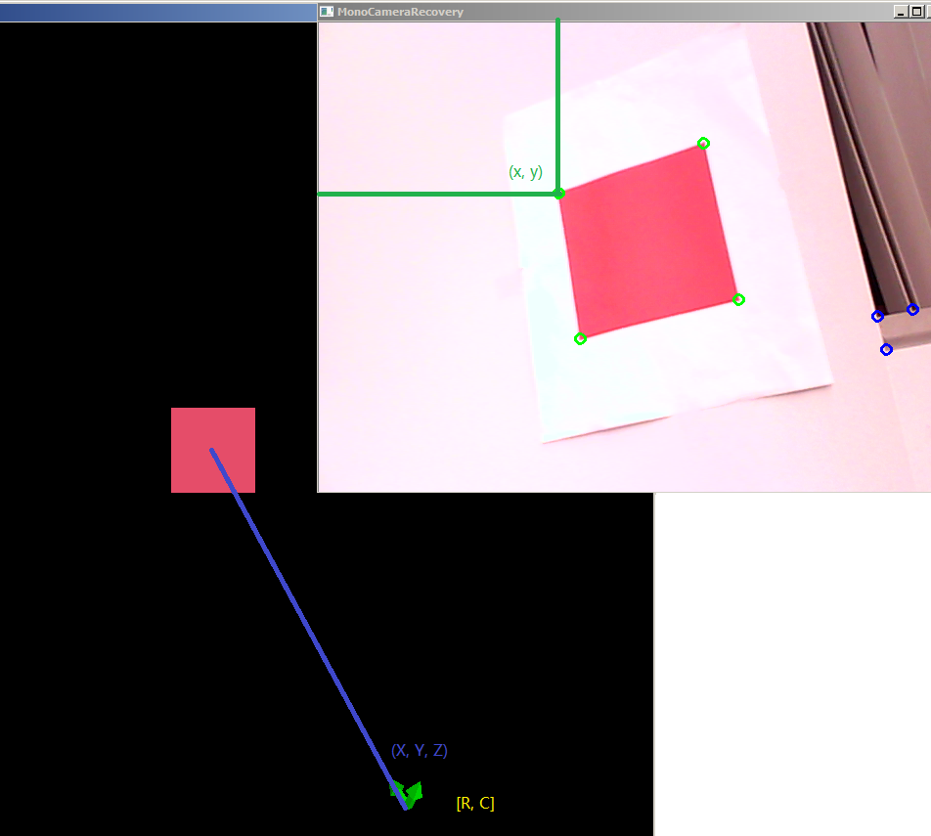
Visual Example

Slide 5
Procedure
Camera Calibration
Camera Capture Image
Filter Red Square
Corner Detection
Find Homography
Find Camera Center

Slide 6
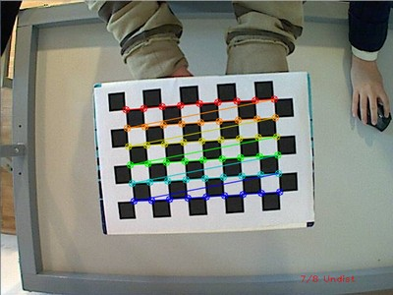
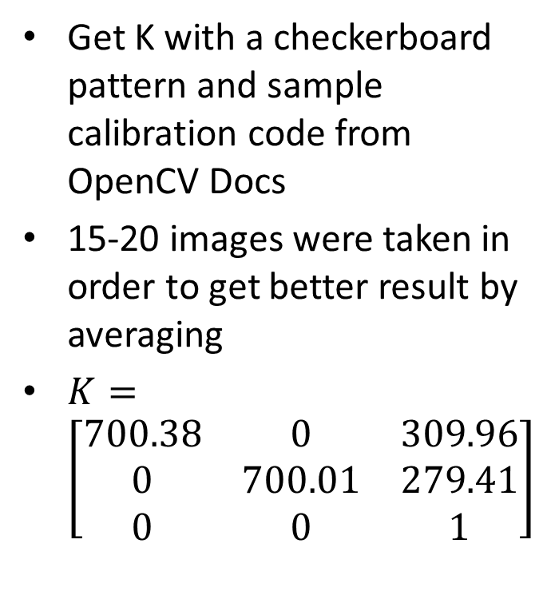
Camera Calibration
Get K with a checkerboard pattern and sample calibration code from OpenCV Docs
15-20 images were taken in order to get better result by averaging
$K=\left[\begin{matrix}700.38 & 0 & 309.96 \\ 0 & 700.01 & 279.41 \\ 0 & 0 & 1\end{matrix}\right]$
Source: http://docs.opencv.org/doc/tutorials/calib3d/camera_calibration/camera_calibration.html
Notes:
Explain K

Slide 7
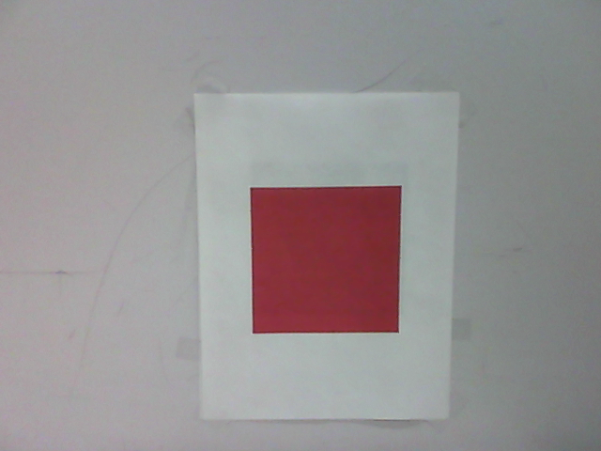
Camera Capture Image
Use OpenCV’s Python bindings
Much faster and more memory efficient compared to the equivalent MATLAB project
Notes:
More memory efficient because MATLAB has to allocate the memory for the camera stream and it does not automatically clear old image cache. OpenCV has better memory management on this regard (old images gets freed in memory)

Slide 8
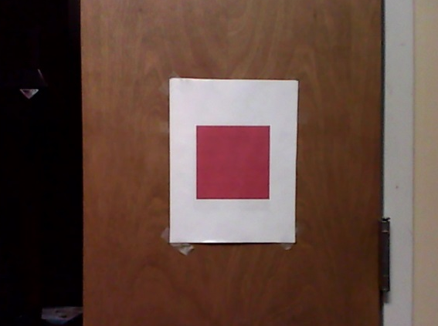
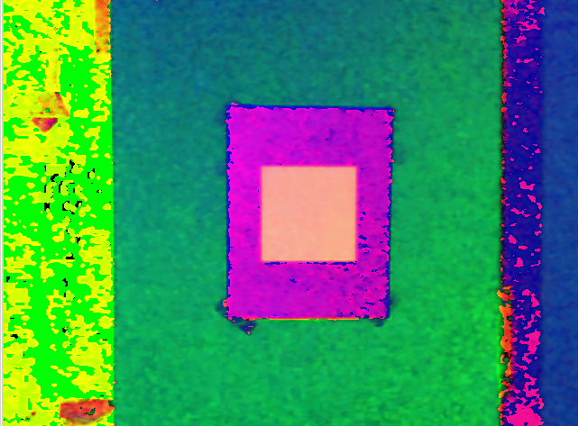
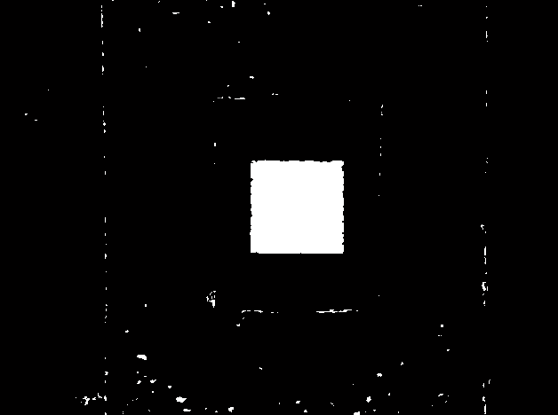

Filter Red Square
Convert RGB to HSV
Build binary mask of the image Based on the Hue, Saturation and Value of the red square color
Get rid of small noise by counting the pixels (contour area in terms of OpenCV) for each connected component
Source: Matt Boutell, CSSE 463 Image Recognition
Notes:
Discuss calibration to color that is used. (Nice, to account for lighting differences)
Discuss that threshold, how robust.
Other colors: red → blue?

Slide 9
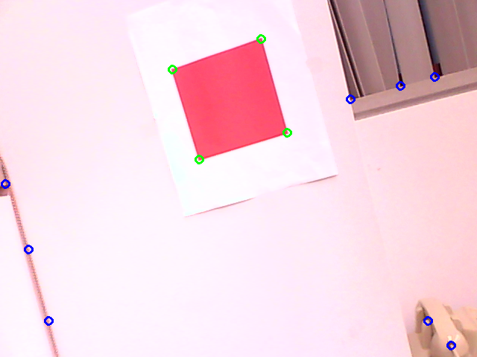

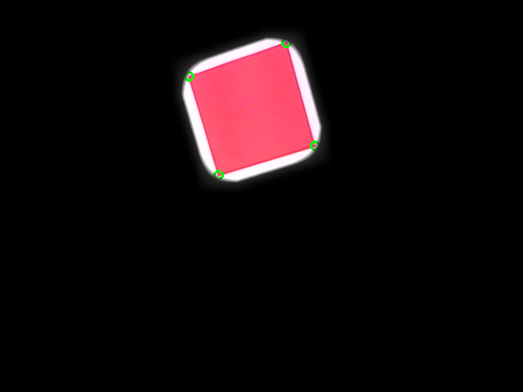
Corner Detection
Find all the possible Corners in the picture using Harris Corner Detection Algorithm
If the corner candidates land on the red square filter, keep them
Blur the red square mask to improve accuracy
Notes:
Discuss Harris = eigenvalues of covariance matrix of window at each point in image. Corners when both eigs are large. (Ref wikipedia: http://en.wikipedia.org/wiki/Corner_detection)
Blur: to make red region larger so can take corners inside the larger red region.

Slide 10
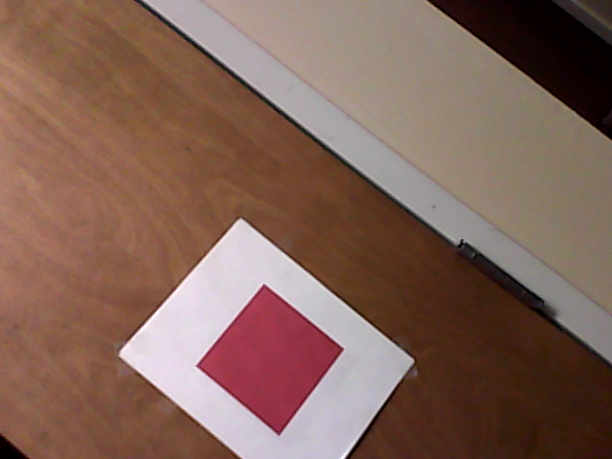
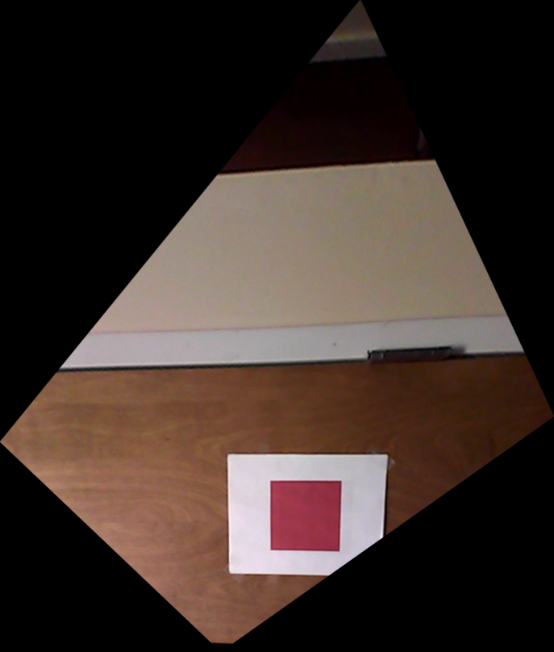
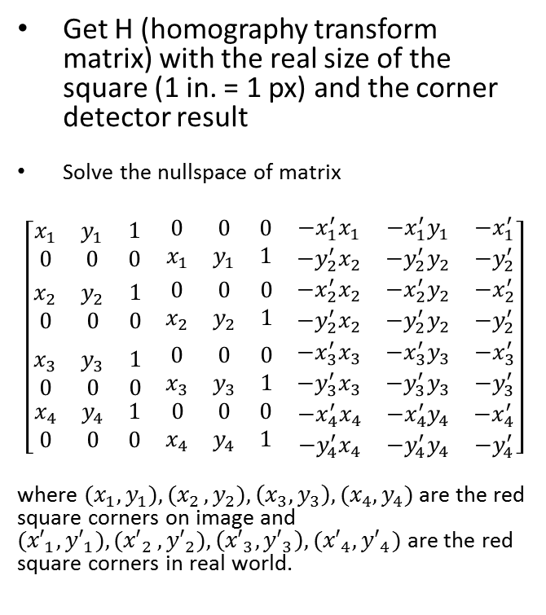
Find homography
Get H (homography transform matrix) with the real size of the square (1 in. = 1 px) and the corner detector result
Solve the nullspace of matrix
$$\left[\begin{matrix}\begin{matrix}x_{1} & y_{1} & 1 \\ 0 & 0 & 0\end{matrix} & \begin{matrix}0 & 0 & 0 \\ x_{1} & y_{1} & 1\end{matrix} & \begin{matrix}−x_{1}^{′}x_{1} & −x_{1}^{′}y_{1} & −x_{1}^{′} \\ −y_{2}^{′}x_{2} & −y_{2}^{′}y_{2} & −y_{2}^{′}\end{matrix} \\ \begin{matrix}x_{2} & y_{2} & 1 \\ 0 & 0 & 0\end{matrix} & \begin{matrix}0 & 0 & 0 \\ x_{2} & y_{2} & 1\end{matrix} & \begin{matrix}−x_{2}^{′}x_{2} & −x_{2}^{′}y_{2} & −x_{2}^{′} \\ −y_{2}^{′}x_{2} & −y_{2}^{′}y_{2} & −y_{2}^{′}\end{matrix} \\ \begin{matrix}\begin{matrix}x_{3} & y_{3} & 1 \\ 0 & 0 & 0\end{matrix} \\ \begin{matrix}x_{4} & y_{4} & 1 \\ 0 & 0 & 0\end{matrix}\end{matrix} & \begin{matrix}\begin{matrix}0 & 0 & 0 \\ x_{3} & y_{3} & 1\end{matrix} \\ \begin{matrix}0 & 0 & 0 \\ x_{4} & y_{4} & 1\end{matrix}\end{matrix} & \begin{matrix}\begin{matrix}−x_{3}^{′}x_{3} & −x_{3}^{′}y_{3} & −x_{3}^{′} \\ −y_{3}^{′}x_{3} & −y_{3}^{′}y_{3} & −y_{3}^{′}\end{matrix} \\ \begin{matrix}−x_{4}^{′}x_{4} & −x_{4}^{′}y_{4} & −x_{4}^{′} \\ −y_{4}^{′}x_{4} & −y_{4}^{′}y_{4} & −y_{4}^{′}\end{matrix}\end{matrix}\end{matrix}\right]$$
where ${(x}_{1}, y_{1}){,(x}_{2}, y_{2}),\left(x_{3},y_{3}\right),(x_{4},y_{4})$ are the red square corners on image and ${(x′}_{1}, {y′}_{1}){,(x′}_{2}, {y′}_{2}),\left({x′}_{3},{y′}_{3}\right),({x′}_{4},{y′}_{4})$ are the red square corners in real world.
Notes:
Remind of variables. H, x1, x2, … in the image.
Note about origin.

Slide 11

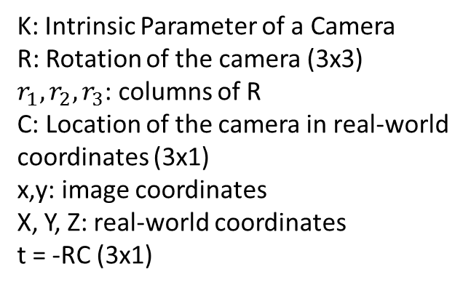

Apply the Math
$$x^{′}=PX$$
$$P=KR[ I |−C]$$
Recover first 2 columns of R and t = -RC by multiplying the inverse of K with H.
Get the 3rd column of R by finding the cross product of the first two columns.
Find C by multiplying the inverse of R by t, then negating the result.
Magnitude of C = the straight distance from the camera center to the center of the square.
Multiply R by <0, 0, -1>, and multiply R by <0, 1, 0> to find the rotation.
$$x^{′}=Hx$$
K: Intrinsic Parameter of a Camera
R: Rotation of the camera (3x3)
$r_{1}, r_{2}, r_{3}$: columns of R
C: Location of the camera in real-world coordinates (3x1)
x,y: image coordinates
X, Y, Z: real-world coordinates
t = -RC (3x1)

Slide 12
Live Demo

Slide 13
Issues / Concerns
Rotation Matrix and Position Vector
Raw result is partially flipped
For R, I needed to extract the Eulerian angles, and rebuild R based on the flipped rotations.
Accuracy
Can be improved by averaging
Use continuity of video stream to improve corner detection

Slide 14
Questions?

Slide 15
Thank You!

